Slide 1
Video Compression Basics

Slide 2
Video compression fundaments
since a video stream has 2 spatial and 1 temporal dimensions, video compression is usually done independently in the spatial dimensions and, respectively, in the time dimension
in the spatial dimensions – compression tries to eliminate spatial redundancy (like in JPEG)
in the time dimension – compression tries to eliminate temporal redundancy (i.e. motion of objects)

Slide 3
Video compression fundaments (2)
the spatial encoder typically works on 8 x 8 pixel blocks of a frame
the temporal encoder typically works on 16 x 16 pixel image blocks
motion estimation/compensation is used for the temporal encoder; motion estimation unit create motion vectors for each 16 x 16 block
there are 3 types of frames:
  I-frames : intracoded frames, key frames
  P-frames: predicted frames
  B-frames: bi-directional predicted frames

Slide 4
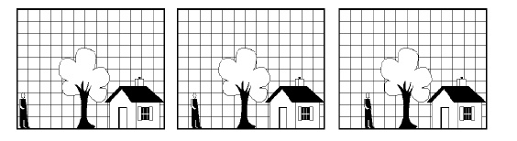
Compression in the time domain
difference between consecutive frames is often small
remove inter-frame redundancy
sophisticated encoding, relatively fast decoding

Slide 5
Video compression standards
there are 2 family of standards: ISO/IEC MPEG and ITU-T
International Standardization Organization(ISO), International Electrotechnical Commission (IEC) , MPEG (Moving Pictures Experts Group) produced the MPEG standards:
  MPEG-1, 1992 : video standards for CDROMs and Internet video
  MPEG-2, 1994 : video standards for television and telecommunications standards
  MPEG-4, 1999 : advanced video coding standards
  MPEG-7, 2001 : metadata for audio-video streams, Multimedia Content Description Interface
  MPEG-21, 2002 : distribution, exchange, user access of multimedia data and intellectual property management

Slide 6
Video compression standards (2)
International Telecommunication Union (ITU-T) developed several recommendations for video coding:
  H.261, 1990 : the first video codec specification, “Video Codec for Audio Visual Services at p x 64kbps”
  H.262, 1995 : Infrastructure of audiovisual services—Coding of moving video
  H.263, 1995 : Video coding for low bit rate communications
  H.264, 2002 : Advanced Video Codec (AVC), in conjunction with MPEG-4

Slide 7
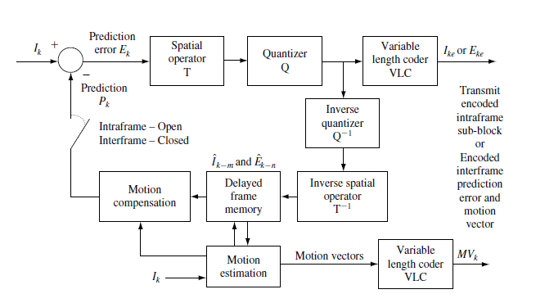
General design of a video encoder

Slide 8
Frame Intracoding
a frame is intracoded similar to the way a JPEG encoder encodes images
Spatial Operator T refers to DCT (Discrete Cosine Transform)
Quantizer Q refers to the quantization matrix
VLC refers to Variable Length Coding, i.e. run-length encoding (including zig-zag order) plus entropy encoding (Huffman encoding)

Slide 9
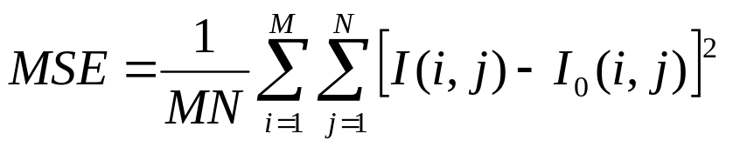
Motion estimation/compensation
was invented in 1960s
is based on the idea that motion in a video is created by solid objects which move on a relatively fixed background
comprises 3 steps:
  first stage estimates objective motion (motion estimation) between the previously reconstructed frame and the current frame; results MVs (Motion Vectors) for each 16x16 block of pixels
  the second stage creates the current frame prediction (MC) using the motion estimates and the previously reconstructed frame
  the final stage encodes the difference between the prediction and the actual current frame (i.e. the prediction error) and the MVs
for motion estimation MSE (Mean Squared Error) is used:

Slide 10
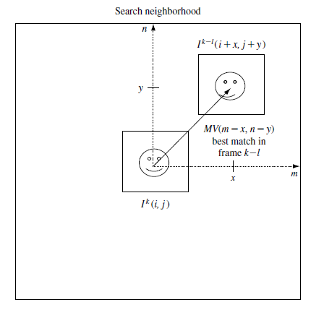
Motion estimation/compensation (2)

Slide 11
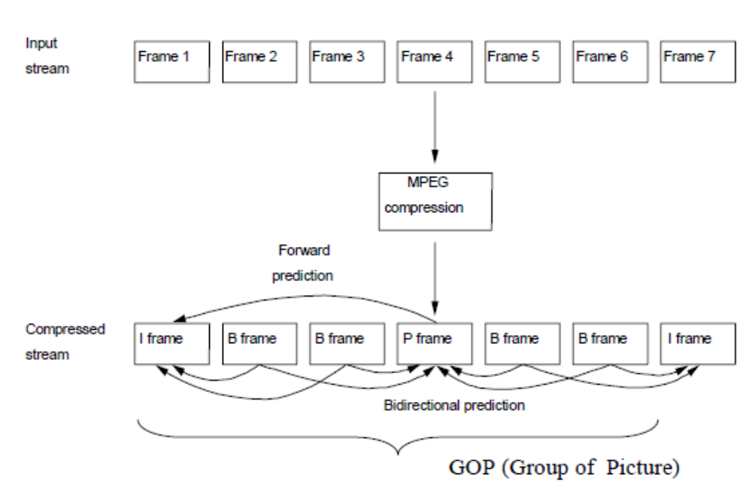
Compressed video stream

Slide 12
MPEG-1

Slide 13
MPEG-1
developed by the Working Group 11 (WG11) of SubCommittee 29 (SC29) of the Joint ISO/IEC Technical Committee 1 (JTC 1) on Information Technology; informally MPEG (Motion Picture Experts Group)
was developed between 1988-1990
in 1992-1994 reached an International Standard
was based on JPEG work and the ITU-T Recommendation H.261
the goal was a coding standard for digital video and audio motion picture for digital storage media at about 1.5 Mbps; so that the video (approx. 1 hour long) can be stored on a CD, VCD (Video Compact Disk) – which is approx. 648 MBytes large

Slide 14
MPEG-1 parts
the MPEG-1 standard only specifies the syntax of the bit stream and the semantics/operation of the decoding process and leaves out the design of the encoder and decoder (to stimulate competition and industry product differentiation) although it provides a reference implementation
MPEG-1 was designed mainly for storage on reliable storage spaces, not for transmission on noisy channels
the standard has 5 parts/layers:
  1. systems (11172-1)
  2. video (11172-2)
  3. audio (11172-3) – includes MPEG-1 Layer III (.mp3)
  4. conformance testing (11172-4)
  5. software simulation (11172-5)

Slide 15
MPEG-1 target applications
MPEG-1 was designed basically for storage on CDs, VCDs, digital audio tapes at a rate of approx. 1.5 Mbps
MPEG-1 targeted an asymmetric encoding-decoding process; encoding process is more complex and processing demanding and it is done usually once while decoding is simpler and is done more frequently
it should have the following features: playback, frame-based random access and editing, reverse playback, fat forward/backward play, mild robustness to uncorrectable errors.
the decoder must be low cost

Slide 16
MPEG-1 Part 1, Systems
MPEG-1 Systems specifies the layout and methods for multiplexing encoded audio (max. 32 streams), video (max. 16 streams) and other data streams (max. 2) in a standard bitstream while maintaining synchronization between these different stream contents
MPEG-1 Systems stream was later renamed to MPEG-1 Program Stream (because its design is identically to MPEG-2 Program Stream)
the Program Stream is intended for storage and transmission over relatively reliable data channels (offers limited error protection)
the Program Stream multiplexes Packetized Elementary Streams(PES) into a standard bitstream
a PES is made from packetizing an Elementary Stream (ES- a raw audio or video bitstream output by an MPEG-1 encoder) and adding a CRC (Cyclic Redundancy Check) checksum to each packet
90 KHz resolution PTS (Presentation TimeStamp) and DTS (Decoding TimeStamp) values help synchronize I-,P- and B-frames in the Program Stream

Slide 17
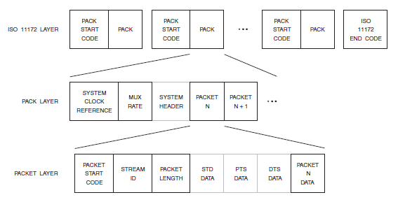
MPEG-1 Program Stream

Slide 18
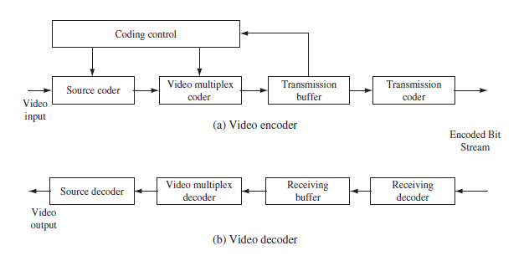
MPEG-1 Part 2, Video – codec design

Slide 19
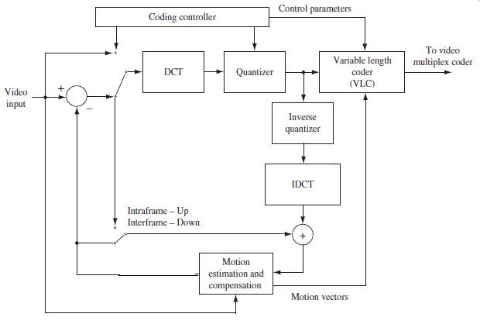
MPEG-1 source encoder implementation

Slide 20
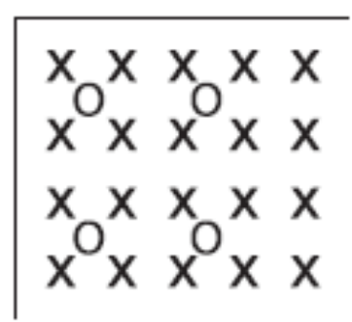
MPEG-1 input source
MPEG-1 process only progressive analog video (not interlaced)
the input format for MPEG-1 video is SIF (Source Input Format): a YCbCr 4:2:0 subsampled 352x240 resolution for NTSC, 30 fps, or 352x288 resolution for PAL, 25 fps, format
picture format:
x – luminance component, o – chrominance component

Slide 21
MPEG-1 types of frames
I-frame - intra-coded (key) frames; frames that are coded independently of other frames similar to JPEG; allows random access and editing to video streams
P-frame – (forward-) predicted frames; inter-frames that are coded as the difference between the current frame and the previous (I- or P-frame); the P-frame can have intra-coded macroblocks and forward-predicted macroblocks; for each forward-predicted macroblock it is coded the prediction error (difference) and 1 motion vector
B-frame – bidirectional predicted-frames or backward-predicted frames; achieves the best compression; are coded as the difference between the current frame and the I- or P- frame preceding it and the I- or P-frame after it; the B-frame can have intra-coded, forward-predicted and backward-predicted macroblocks; for each backward-predicted macroblock it is coded the prediction error (average difference) and 2 motion vectors
D-frame – DC-frames; only the DC coefficient of each macroblock is coded; are used for previewing a video

Slide 22
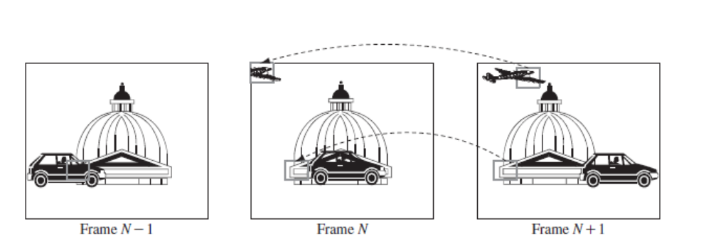
Bidirectional motion compensation prediction (B-frames)
for motion estimation only the luminance component is compared
better prediction can be provided if both the past and the future frames are used

Slide 23
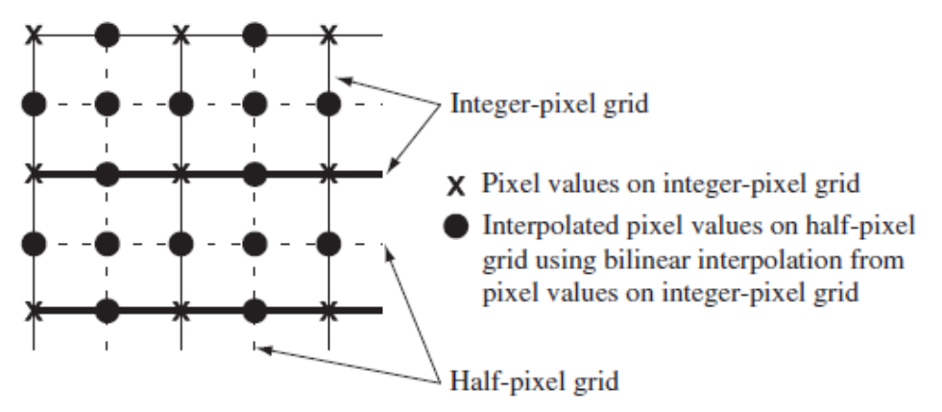
Motion compensation with half-pixel accuracy
often, a macroblock moves to a position that is not on the pixel grid, but between pixels
this is why MPEG-1 has half-pixel accuracy in motion estimation (the half-pixel value is computed using bilinear interpolation)

Slide 24
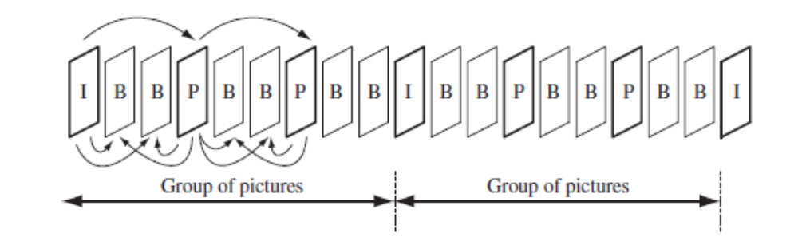
GOP (Group of pictures)
each video sequence is divided into GOPs
there are 4 types of pictures: I-frame, P-frame, B-frame, D-frame
DC pictures (D-pictures) are low-resolution pictures obtained by decoding only the DC coefficient of the discrete cosine transform (DCT) coefficients of each macroblock.

Slide 25
Slices, macroblocks, blocks
an MPEG-1 picture is made from slices
slice – continuous sequence of macroblocks in a raster scan order (from left to right and top to bottom)
macroblock – a 16x16 block of luminance samples, one 8x8 Cb block and 8x8 Cr block; a coded macroblock contains (frame) prediction error and one or two motion vectors
block – a matrix of Y/Cb/Cr samples (usually 16x16 or 8x8)

Slide 26
Macroblock encoding
for each macroblock there is a quantization scale (between 1 and 31) which is multiplied by a quantization weighting matrix and so results the quantization matrix for the macroblock
2 types of intracoded macroblock for I-frames:
  intra-d – uses the current (of the previous macroblock) quantization scale
  intra-q – defines a new quantization scale; the macroblock header specifies a 5-bit quantizer scale factor
8 types of macroblocks for P-frames: intra-d, intra-q, pred-m, pred-c, pred-mc, pred-cq, pred-mcq, skipped
12 types of macroblocks for B-frames: intra-d, intra-q, pred-i, pred-ic, pred-b, pred-bc, pred-f, pred-fc, pred-icq, pred-fcq, pred-bcq, skipped

Slide 27
Macroblock types in P-frames
intra-d and intra-q : the same as used in I-frames
pred-m : the macroblock is forward-predictive encoded (difference from the previous frame) using a forward motion vector
pred-c : the macroblock is encoded using a coded pattern; a 6-bit coded block pattern is transmitted as a variable-length code and this tells the decoder which of the 6 blocks in the macroblock are coded (1) and which are not coded (0)
pred-mc : the macroblock is forward-predictive encoded using a forward motion vector and also a 6-bit coded pattern is included
pred-cq : a pred-c macroblock with a new quantization scale
pred-mcq : a forward-predictive macroblock encoded using a coded pattern with a new quantization scale
skipped : they have a zero motion vector and no code; the decoder copies the corresponding macroblock from the previous frame into the current frame

Slide 28
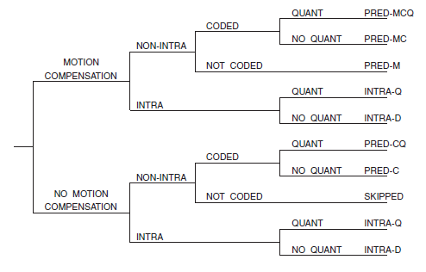
Macroblock encoding in P-frames
the macroblock encoding process in P-frames chooses the type of a macroblock using an algorithm like this:

Slide 29
Macroblock types in B-frames
intra-d, intra-q : the same as used for I-frames
pred-i : bidirectionally-predictive encoded macroblock with forward motion vector and backward motion vector
pred-ic : a pred-c macroblock encoded using a 6-bit coded pattern
pred-b : backward-predictive encoded macroblock with backward motion vector
pred-bc : a pred-b macroblock encoded using a 6-bit coded pattern
pred-f : forward-predictive encoded macroblock with forward motion vector
pred-fc : a pred-b macroblock encoded using a 6-bit coded pattern
pred-icq : a pred-ic macroblock with a new quantization scale
pred-fcq : a pred-fc macroblock with a new quantization scale
pred-bcq : a pred-bc macroblock with a new quantization scale
skipped : the same as for P-frames

Slide 30
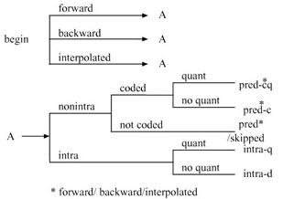
Macroblock encoding in B-frames
the macroblock encoding process in B-frames chooses the type of a macroblock using an algorithm like this:

Slide 31
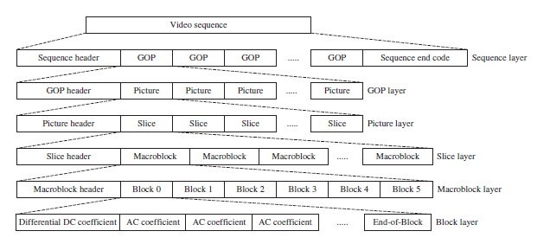
MPEG-1 video bitstream syntax

Slide 32
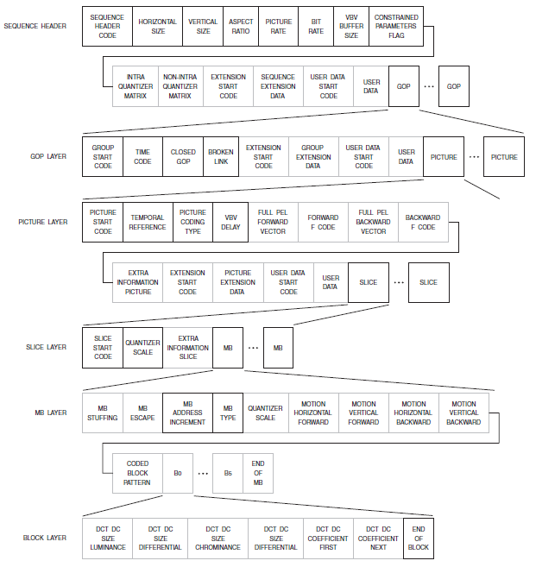
MPEG-1 video bitstream syntax - detail

Slide 33
MPEG-1 video bitstream syntax structures
video sequence layer header contains: the picture size (horizontal and vertical), pel aspect ratio, picture rate, bit rate, minimum decoder buffer size, constraint parameters flag, control for loading 64-bit values for intra and nonintra quantization tables and user data
GOP layer header contains: the time interval from the start of the video sequence, the closed GOP flag (decoder needs frames from previous GOP or not?), broken link flag and user data
picture layer header contains: the temporal reference of the picture, picture type (I,P,B,D), decoder buffer initial occupancy, forward motion vector resolution and range for P- and B-frames, backward motion vector resolution and range for B-frames and user data
slice layer header contains: vertical position where the slice starts and the quantizer scale for this slice
macroblock layer header contains: optional stuffing bits, macroblock address increment, macroblock type, quantizer scale, motion vector, coded block pattern
a block contains 8x8 coded DCT coefficients

Slide 34
MPEG-1 Layer III Audio (.mp3)

Slide 35
MPEG-2

Slide 36
Need for MPEG-2
MPEG-1 allowed rates of 1.5 Mbps at SIF resolution and higher resolution coding standards were needed for direct video broadcasting and storage on DVB, DVD
MPEG-1 allowed encoding only of progressive scan sources, not interlaced scan sources
MPEG-1 provides limited error concealment for noisy channels
a more flexible choice of formats, resolutions and bitrates was needed

Slide 37
MPEG-2
MPEG-2 was designed mainly for storage (DVD, DVB) and transmission on noisy channels (direct terrestrial or satellite TV broadcast)
MPEG-2 standards were published as ISO/IEC 13818
like MPEG-1, the MPEG-2 standard only specifies the syntax of the bit stream and the semantics/operation of the decoding process and leaves out the design of the encoder and decoder (to stimulate competition and industry product differentiation) although it provides a reference implementation
developed between 1991-1993
parts of MPEG-2 reached International Standard in 1994, 1996, 1997, 1999
MPEG-3 was originally intended for HDTV at higher bitrates, but was merged with MPEG-2

Slide 38
MPEG-2 parts
part 1, Systems : synchronization and multiplexing of audio and video
part 2, video
part 3, audio
part 4, testing compliance
part 5, software simulation
part 6, extensions for Digital Storage Media Command and Control (DSM-CC)
part 7, Advanced Audio Coding (AAC)
part 9, extensions for real time interfaces
part 10, conformance extensions for DSM-CC
part 11, Intellectual Property Management and Protection
[ part 8 withdrawn due to lack of industry interest ]
Notes:
6

Slide 39
MPEG-2 target applications
coding high-quality video at 4-15 Mbps for video on demand (VOD), standard definition (SD) and high-definition (HD) digital TV broadcasting and for storing video on digital storage media like the DVD
MPEG-2 should have scalable coding and should include error resilience techniques
MPEG-2 should provide good NTSC quality video at 4-6 Mbps and transparent NTSC quality video at 8-10 Mbps
MPEG-2 should provide random access to frames
MPEG-2 should be compatible with MPEG-1 (an MPEG-2 decoder should be able to decode an MPEG-1 bitstream)
low cost decoders

Slide 40
MPEG-2 Systems
MPEG-2 Systems offers 2 types of multiplexation bitstreams:
  Program Stream: it consists of a sequence of PESs, similar and compatible to MPEG-1 Program (System) Stream, but containing additional features; MPEG-2 PS is a superset of MPEG-1 PS; it is suited for error-free transmission environments and has long and variable length packets (typically 1-2KB, but can also be 64KB) for coding efficiency; it has features not present in MPEG-1 PS like: scrambling of data, assigning different priorities to packets, alignment of elementary stream packets, copyright indication, fast forward and fast reverse indication.
  Transport Stream: designed for transmission through noisy channels; has a small fixed size packet of 188 bytes; it is suited for cable/satellite TV broadcasting, ATM networks; allows synchronous multiplexing of programs with independent time bases, fast access to the desired program for channel hoping
PES (Packetized Elementary Stream) – is the central structure used in both Program and Transport Streams; results from packetizing cntinuous streams of compressed audio or video

Slide 41
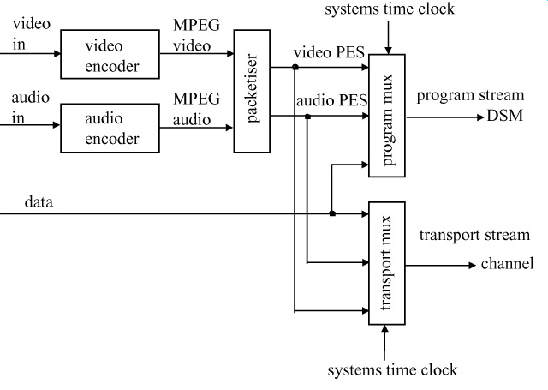
MPEG-2 Systems multiplexation
(digital storage media)

Slide 42
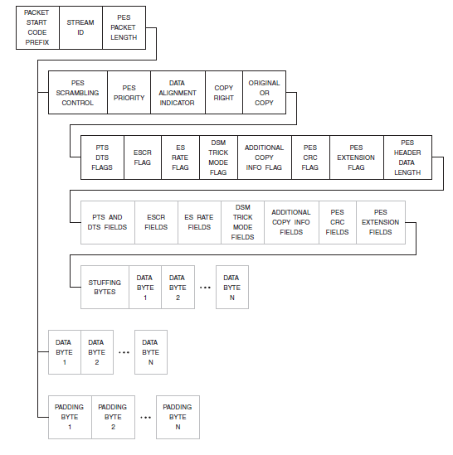
Packetized Elementary Streams (PES)

Slide 43
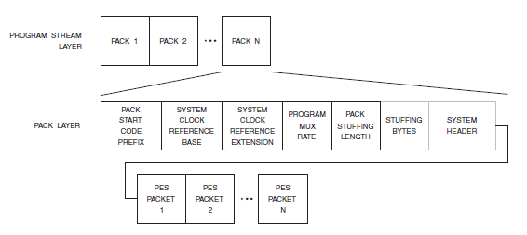
Program Stream structure (simplified)

Slide 44
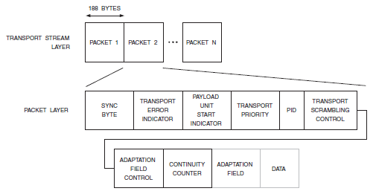
Transport Stream Structure (simplified)

Slide 45
MPEG-2 Profiles and Levels
MPEG-2 is designed o cover a wide range of applications, but not all features are needed by all applications
MPEG-2 groups application features into 7 profiles and profiles have different levels
simple profile – for low-delay video conferencing applications using only I- and P- frames
main profile – most used, high quality digital video apps.
SNR (signal to noise ratio) scalable – supports multiple grades of video quality
spatially scalable - supports multiple grades of resolution
high – supports multiple grades of quality, resolution and chroma formats
4:2:2
multiview

Slide 46
MPEG-2 Profiles and Levels (2)
there are 4 levels for each profile:
low (for SIF pictures)
main (for ITU-R BT 601 resolution pictures)
high-1440 (for European HDTV resolution pictures)
high (for North America HDTV resolution pictures)

Slide 47
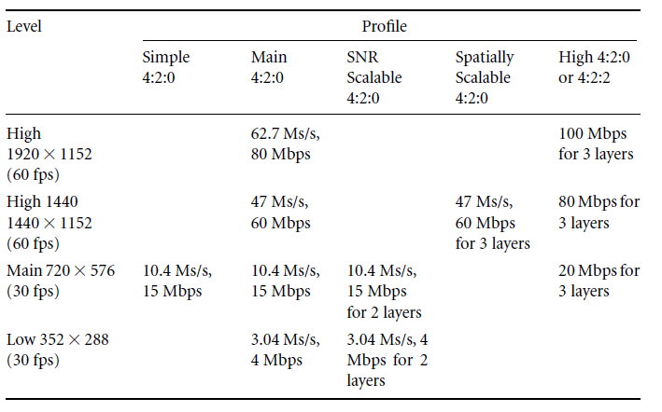
MPEG-2 Profiles and Levels (3)

Slide 48
Scalable coding
scalable coding – means coding the audio-video stream into a base layer and some enhancement layers, so that when the base layer is decoded basic quality is achieved, but if the transmission channel allows it, decoding enhancement layers brings additional quality to the decoded stream
there are 4 types of scalability
  SNR scalability
  spatial scalability
  temporal scalability
  hybrid (combination of the above)

Slide 49
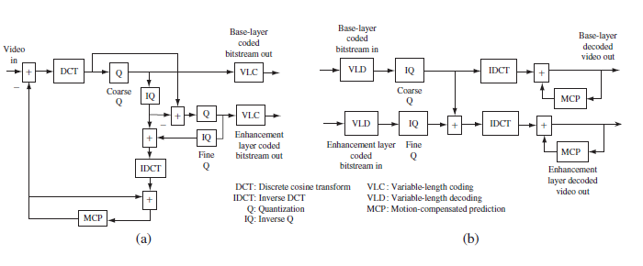
SNR scalability

Slide 50
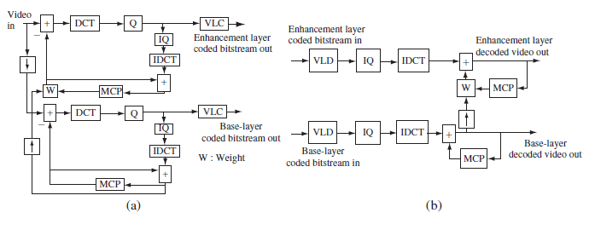
Spatial scalability

Slide 51
Encoding of interlaced video
MPEG-2 allows encoding of interlaced video and a frame can be intracoded or intercoded as a picture or as a field of picture
motion estimation/compensation can be between frames or between fields

